Slide 1

Timing and Synchronisation in Computers and Distributed Systems
Presented By Soham Bhattacharyya (19BCE1199)

Slide 2
Clocks in Computers
Clocks
Real Time Clock
System Clock
Runs in shut down state
Hardware component
Synchronisation and scheduling
Setting and managing interrupts
Setting timer et cetera

Slide 3
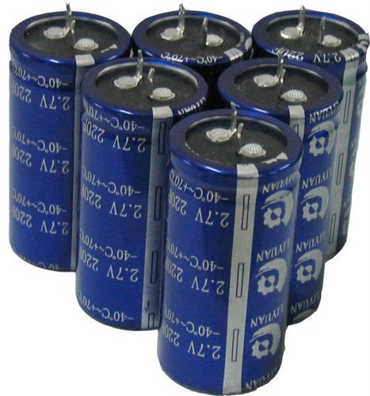
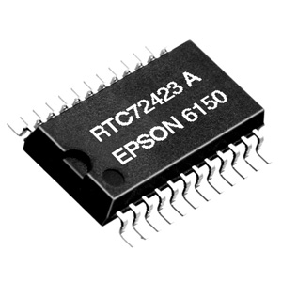
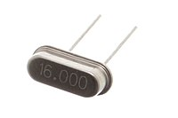
Real Time Clock
Super-capacitor
Exactly 2¹⁵ cycles per second
Analog to Digital Converter
Quartz crystal
Output

Slide 4
System Clock
POSIX epoch (1st January 1970 00:00:00)
RTC
Prior Boot-up
Post Boot-up
System Clock
Gets time of day
Sets timestamps on files et cetera
[Current Time]

Slide 5
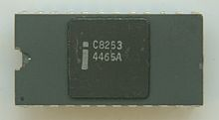
Timer Interrupt Service Routine
Context Switch
CPU
Other processes
Digital Signal from RTC
Programmable Interval Timer
Interrupt
Timer Interrupt Service Routines
Notifying the kernel Scheduler
Updating System Clock

Slide 6
Timer Interrupt Service Routine
Context restored
CPU
Other processes
Digital Signal from RTC
Programmable Interval Timer
Timer Interrupt Service Routines
Returning from Interrupt
Notifying the kernel Scheduler

Slide 7
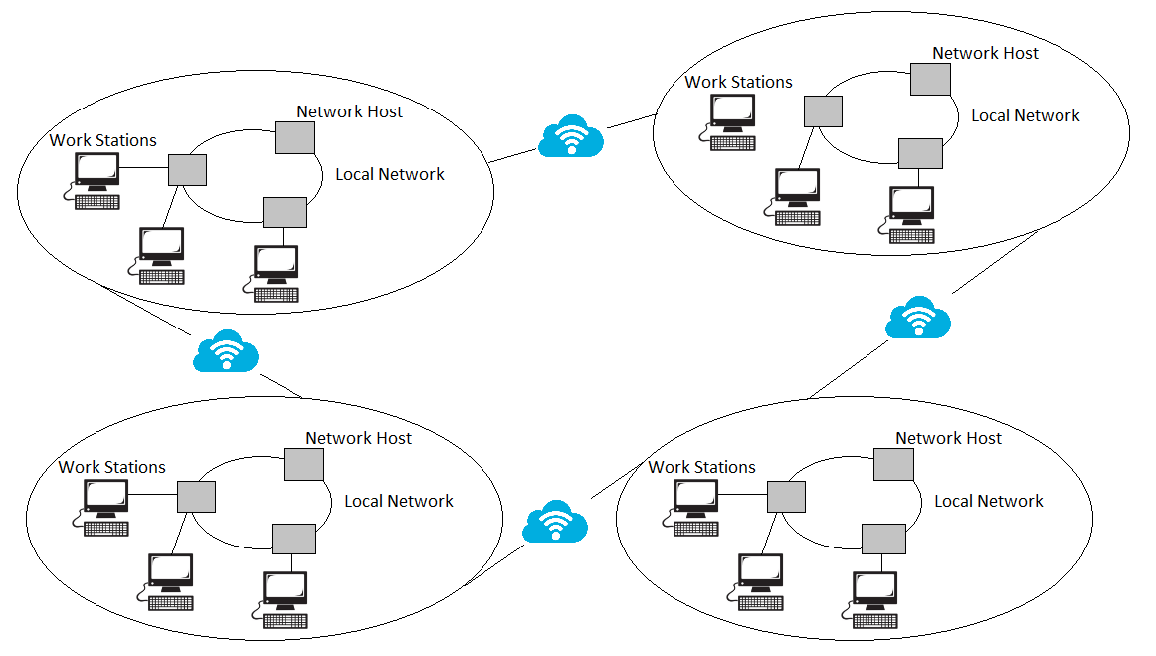
Distributed Systems
Also known as distributed computing
Multiple components communicating and coordinating actions
Functionalities
Work towards a common goal
Function as a single cohesive unit
Each machine has own end user
Facilitates sharing resources
Facilitates sharing communication services

Slide 8
Synchronisation in Distributed Systems
Synchronisation Types
Synchronisation Algorithms
External Clock Sync
Internal Clock Sync
Centralised Sync
Examples:
Berkeley Algorithm
Passive Time Server
Active Time Server
Distributed Sync
Examples:
Global Averaging Algorithm
Local Averaging Algorithm
Network Time Protocol

Slide 9
Berkeley’s Algorithm (A Centralised Sync Algorithm)
Request for Time
Accurate time source/ UTC server
Master Node
Request for Time
Request for Time
Cristian’s Algorithm:
Request sent at T_{o}
Slave Node 1
Request for Time
Slave Node 3
Slave Node 2

Slide 10
Berkeley’s Algorithm (A Centralised Sync Algorithm)
3:00
Accurate time source/ UTC server
Master Node
3:10
3:20
Cristian’s Algorithm:
Request sent at T_{o}
Time fetched as T_{slave}
T_{slave} returned at T₁
T_{slave,effective} = T_{slave} + (T₁-T₀)/2
Slave Node 1
2:50
Slave Node 3
Slave Node 2

Slide 11
Berkeley’s Algorithm (A Centralised Sync Algorithm)
3:05
Accurate time source/ UTC server
Master Node
3:05
3:05
Slave Node 1
3:05
Slave Node 3
Slave Node 2

Slide 12
Global Averaging Algorithm (A Distributed Sync Algorithm)
Average of differences of clock times with its local clock time is taken
Faulty clocks discarded
Limitations
Scalability not good
Need of Broadcast facility
Network traffic is high
May be useful for small networks only
A Node in a network of Nodes
Waiting
Synced Time = Current Time + Average of differences in time with other nodes

Slide 13
THANK YOU

